Slide 1
SCREENLESS DISPLAY
PRESENTED BY
V.Datta Sai
20H51A0525

Slide 2

CONTENTS
Introduction
Architecture/Design
Types
Applications
Advantages and Disadvantages
Future Enhancements
Conclusion

Slide 3
INTRODUCTION
Technologies have made our life easier and more comfortable day by day to solve various types of problems at higher level.
Touch screen technology is accepted by almost all electronics gadgets. The major problem faced by display with screen is that it needs a lot of space.
Screen-less display can be defined as a display which help to display and even transmit any information or image without the need of any screen.
This display technology has emerged as a most interesting technology in IT field.
Using this display we can create image into the air. Using this technology images can be projected directly onto the retina of the human eye and even in the human brain.

Slide 4
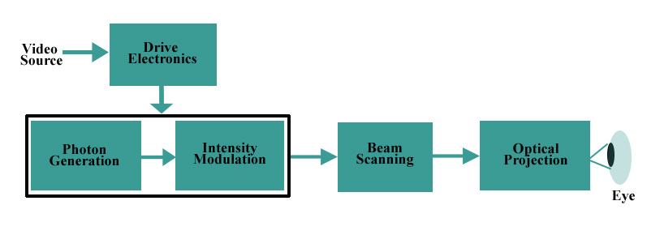
ARCHITECTURE OF SCREENLESS DISPLAY
i) BLOCK DIAGRAM OF SCREENLESS DISPLAY

Slide 5
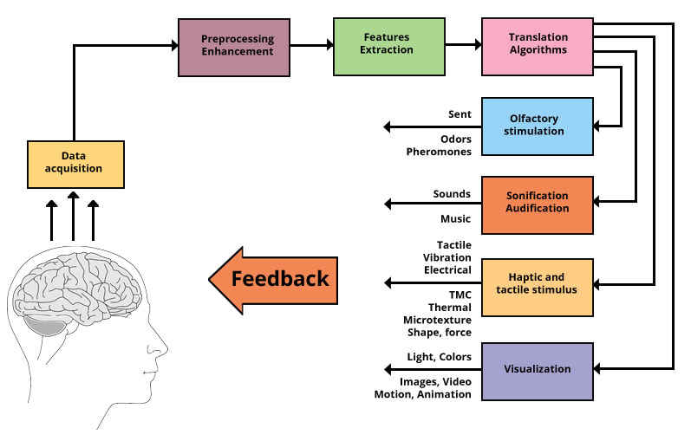
ARCHITECTURE OF SCREENLESS DISPLAY
ii) WORKING DESIGN

Slide 6

TYPES OF SCREENLESS DISPLAY
Screenless display technology is divided into three main categories:
Visual Image Display
Retinal Display
Synaptic Interface

Slide 7
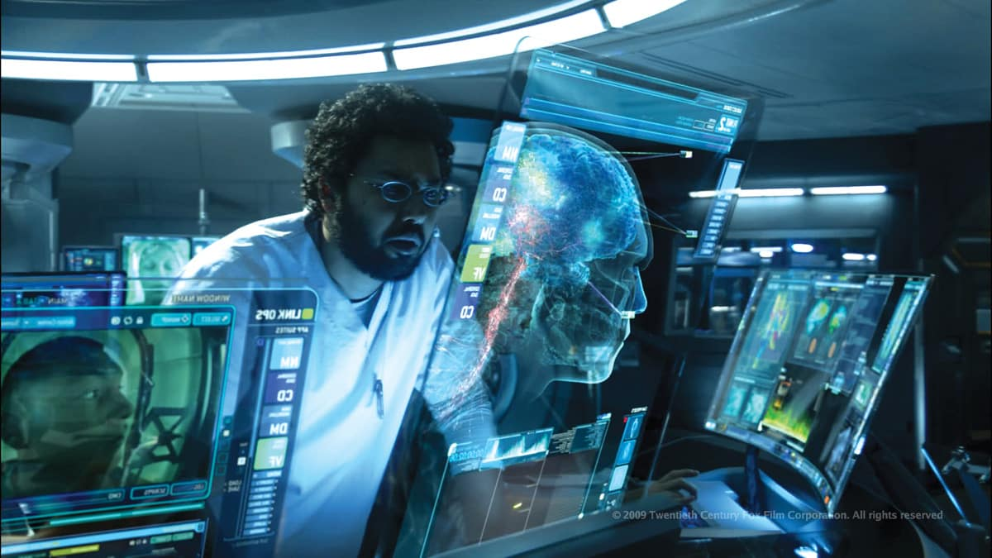
TYPES – Visual Display
Visual Image screenless display includes any image that the eye can perceive.
Light is reflected off some intermediate object before it reaches the retina.
The most common example of Visual Image screenless display is a hologram.

Slide 8

TYPES – Retinal Display
Virtual retinal display systems are a class of screenless displays in which images are projected directly onto the retina.
They are distinguished from visual image systems because light is not reflected from some intermediate object onto the retina, it is instead projected directly onto the retina.

Slide 9

TYPES – Synaptic Interface
Synaptic Interface screenless video does not use light at all.
Visual information completely bypasses the eye and is transmitted directly to the brain.
Such systems have only been implemented in humans in rudimentary form - for example, displaying single Braille characters to blind people.

Slide 10
APPLICATIONS
The main use of the screen less displays are used for the development of the mobile phones which are mainly used by the old and blind people.
Screen less displays technology is also implemented for the development of the screen less laptops. A laptop without an LCD can be a very useful portable solution when connected to CRT or fixed LCD monitors.
Latest laser technology are also implementing the special technique of the screen less display through the presence of the several 3D scope animation.
Screen less displays major working principle can also be implemented in the emerging of the new screen less TV’s.

Slide 11
ADVANTAGES & DISADVANTAGES
Low power requirements
Higher resolution images
Greater portability
Lower costs
More accurate color
The VRD technology is still under progress and development.
The principle disadvantage is that Virtual retinal display (VRD) is not yet available in the significant number.
Prototypes and special experimental models are now being built, but their cost per unit is high.

Slide 12
CONCLUSION
Screen-less Displays: The paper discusses screen-less displays, an emerging computer technology that excites upcoming generations and represents futuristic technology.
Advantages and Challenges: These displays offer numerous advantages but also require significant knowledge and ongoing development efforts.
Future Dominance: Screen-less displays may dominate the future, enriching the world of computer technology and technological empowerment.
Cost-Effective and Promising: They promise cost-effective solutions and a brighter future in the computer technology realm.

Slide 13
FUTURE ENHANCEMENTS
For the future development of this emerging new technology, several researches are being conducted and the several renowned IT sector companies and other best labs present in the world are handling over the project of screenless displays.
CUBIT is being developed for the future use of the multi touch use of the program.
Several laboratories are working under progress on the electron beam lithography which includes the advanced enhancement of the futuristic screen less display.

Slide 14
THANK
YOU

